Slide 1
Introduction to Eclipse

Slide 2
What is Eclipse?
An Integrated Development Environment
Provides many features to ease Java programming (and others, e.g. C/C++)
  Editor
  Debugger
  Source Control
  …

Slide 3
Getting Eclipse
  Download the latest version at:
    http://www.eclipse.org/
  You may need to install Java SDK1.8 or JRE if you haven’t from
    http://www.oracle.com/technetwork/java/javase/downloads/jdk8-downloads-2133151.html

Slide 4
Installing and Running Eclipse
Installation is very simple
  Just unpack the downloaded package
Running Eclipse
  Then click eclipse.exe (under Windows)
  Run eclipse (under Linux)
  Eclipse will start running if all the prerequisites are met
  Demo: Run Eclipse

Slide 5
Setting up your Workspace
Workspace is where your projects and programs are stored.
  Usually some directory in the file system
  The workspace is set when Eclipse starts
  In this course, for instance, we may set the work space to
    /home/username/WorkspaceMODS
    All code will be saved in this directory
    Demo

Slide 6
Some important concepts about Eclipse Environment
Workbench
Perspective
Views
Editor
…

Slide 7
Workbench
The term Workbench refers to the desktop development environment
The Workbench aims to achieve seamless tool integration and controlled openness by providing a common paradigm for the creation, management, and navigation of workspace resources.

Slide 8
Views
Views support editors and provide alternative presentations as well as ways to navigate the information in your Workbench.
For example, the Navigator and other navigation views display projects and other resources that you are working with.

Slide 9
Creating Java Projects
Demo: Creating a ‘Hello World’ project for in a workspace

Slide 10
Creating Java Packages
A Package in Java is a group of classes which are often closely or logically related in some way
Package corresponds to the directory hierarchy in the file system.
  com.nxtGen.helloworld
Organizing source files (.java) into different packages is a good programming style.
Demo: creating a package

Slide 11
Adding Java Classes
Class is the basic compilation unit in Java.
Demo: Creating an Employee

Slide 12
Import existing files
Some files are given and you want to import them to your projects rather than creating them again
You can also copy-and-paste files to your project folder
  Refresh the file view if you don’t see them

Slide 13
Running the code
We need a class which has a main() method as the entrance for execution
…when creating mods, think of main as the main method of execution for all your mods

Slide 14

Launching Eclipse
Once you have the environment setup, go ahead and launch eclipse
You should see the following splash screen…

Slide 15
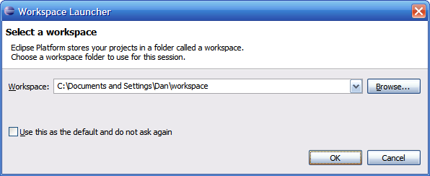
Selecting a Workspace
In Eclipse, all of your code will live under a workspace
A workspace is nothing more than a location where we will store our source code and where Eclipse will write out our preferences
Eclipse allows you to have multiple workspaces – each tailored in its own way
Choose a location where you want to store your files, then click OK

Slide 16
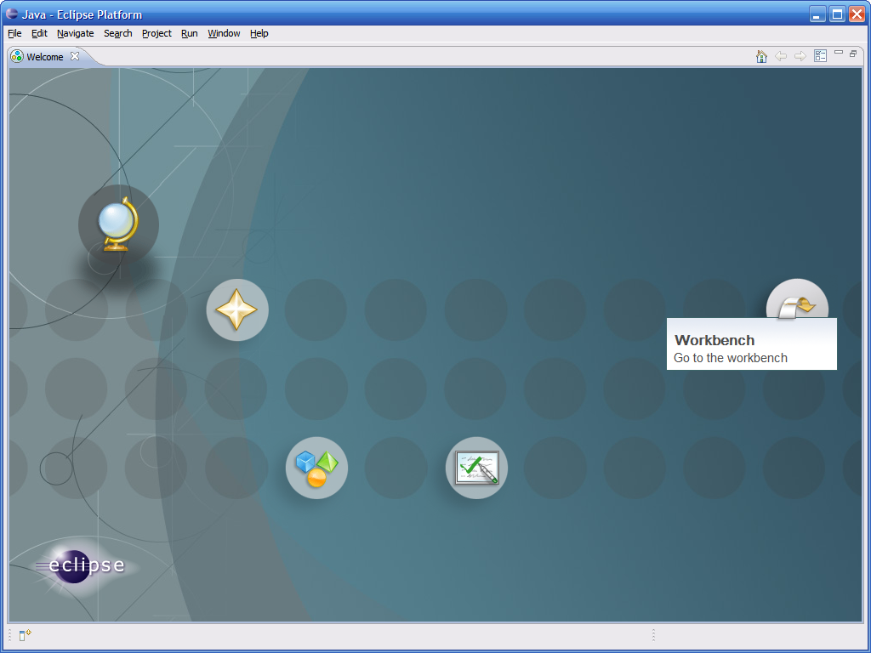
Welcome to Eclipse
The first time you launch Eclipse, you will be presented with a welcome screen
From here you can access an overview to the platform, tutorials, sample code, etc…
Click on the arrow on the right to get to the actual IDE

Slide 17
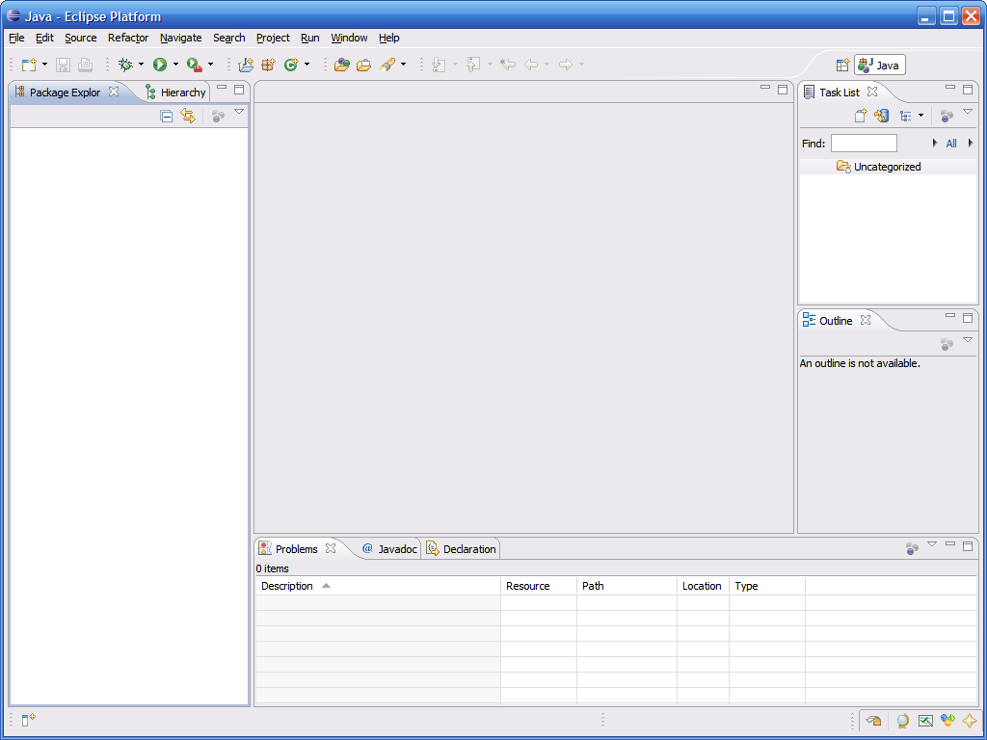
Eclipse IDE Components
Perspective Switcher
We can switch between various perspectives here
Menubars
Full drop down menus plus quick access to common functions
Task List Pane
This contains a list of “tasks” to complete
Editor Pane
This is where we edit our source code
Package Explorer Pane
This is where our projects/files are listed
Outline Pane
This contains a hierarchical view of a source file
Miscellaneous Pane
Various components can appear in this pane – typically this contains a console and a list of compiler problems

Slide 18
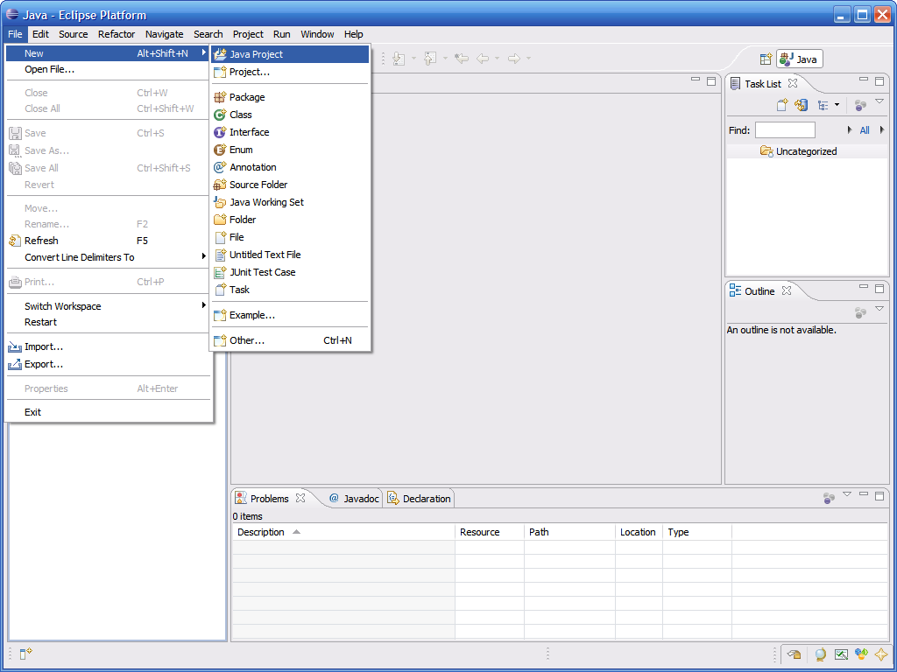
Creating a New Project
All code in Eclipse needs to live under a project
To create a project: File → New → Java Project

Slide 19
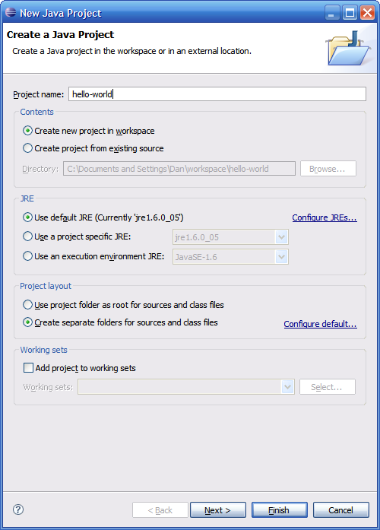
Creating a New Project (continued)
Enter a name for the project, then click Finish

Slide 20
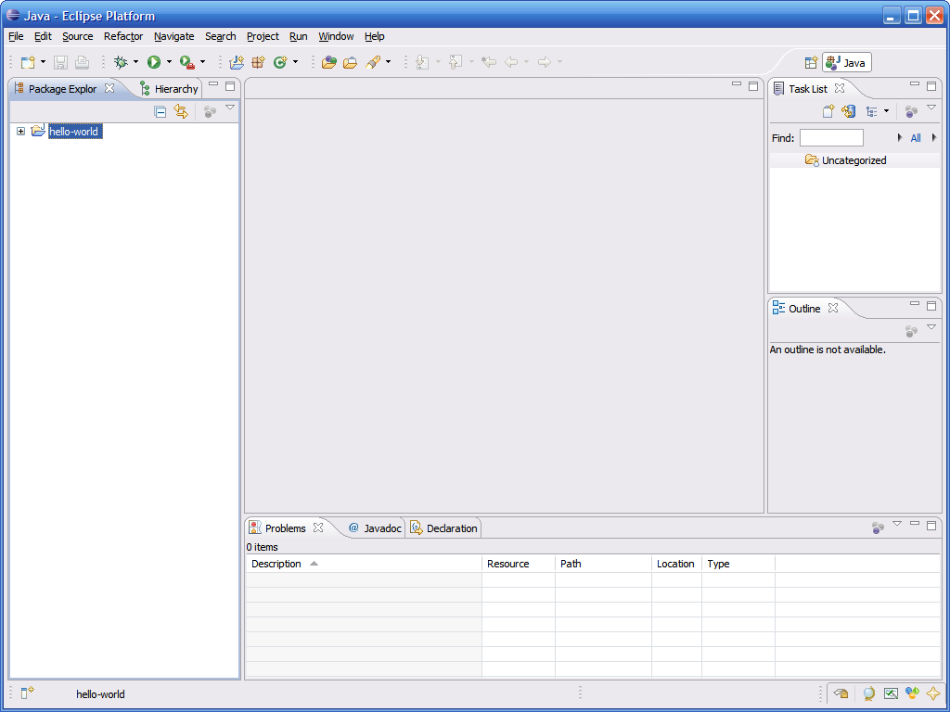
Creating a New Project (continued)
The newly created project should then appear under the Package Explorer

Slide 21
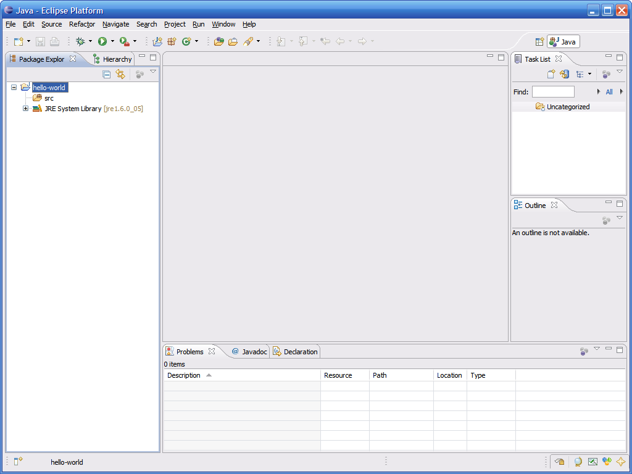
The src folder
Eclipse automatically creates a folder to store your source code in called src

Slide 22
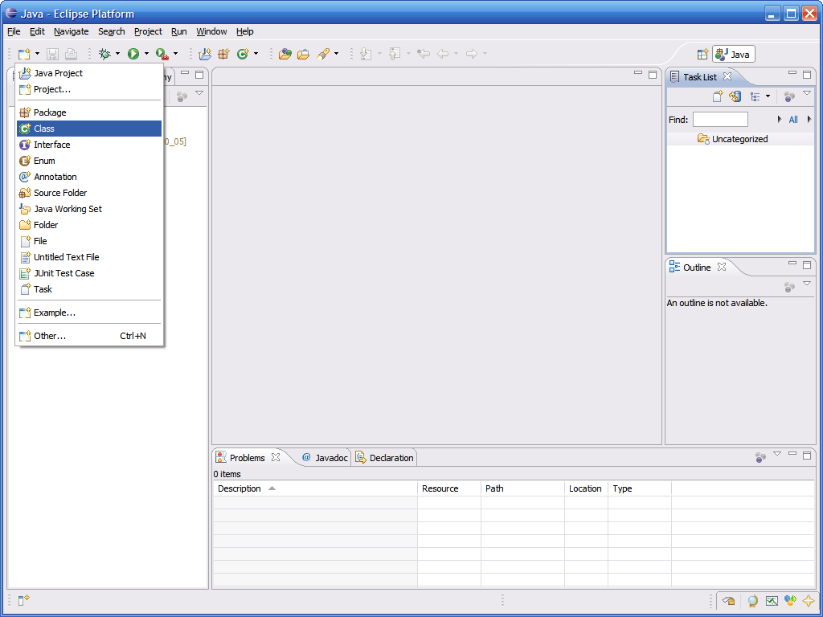
Creating a Class
To create a class, simply click on the New button, then select Class

Slide 23
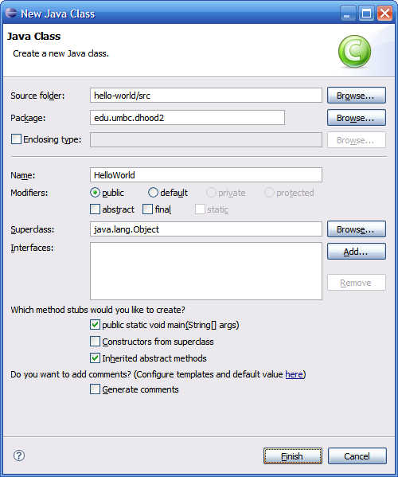
Creating a Class (continued)
This brings up the new class wizard
From here you can specify the following...
  Package
  Class name
  Superclass
  Whether or not to include a main
  Etc…
Fill in necessary information then click Finish to continue

Slide 24
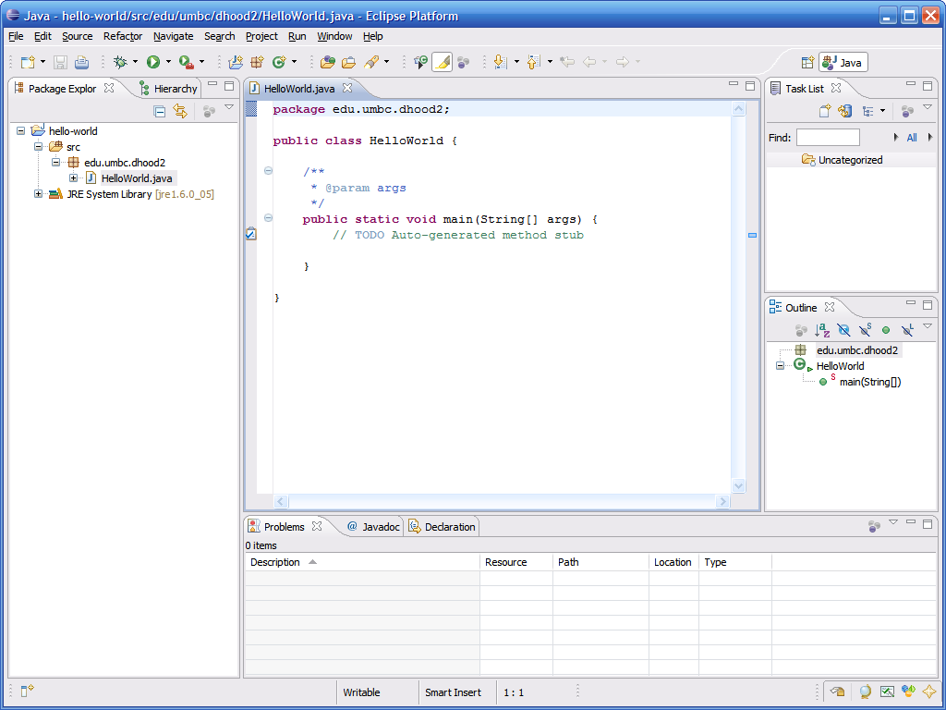
The Created Class
As you can see a number of things have now happened…
Directory structure for package and actual java file created automatically
Source is loaded into the editor pane, already stubbed out
Source displayed in a hierarchical fashion listing each method name

Slide 25
Compiling Source Code
One huge feature of Eclipse is that it automatically compiles your code in the background
  You no longer need to go to the command prompt and compile code directly
This means that errors can be corrected when made
  We all know that iterative development is the best approach to developing code, but going to shell to do a compile can interrupt the normal course of development
  This prevents going to compile and being surprised with 100+ errors

Slide 26
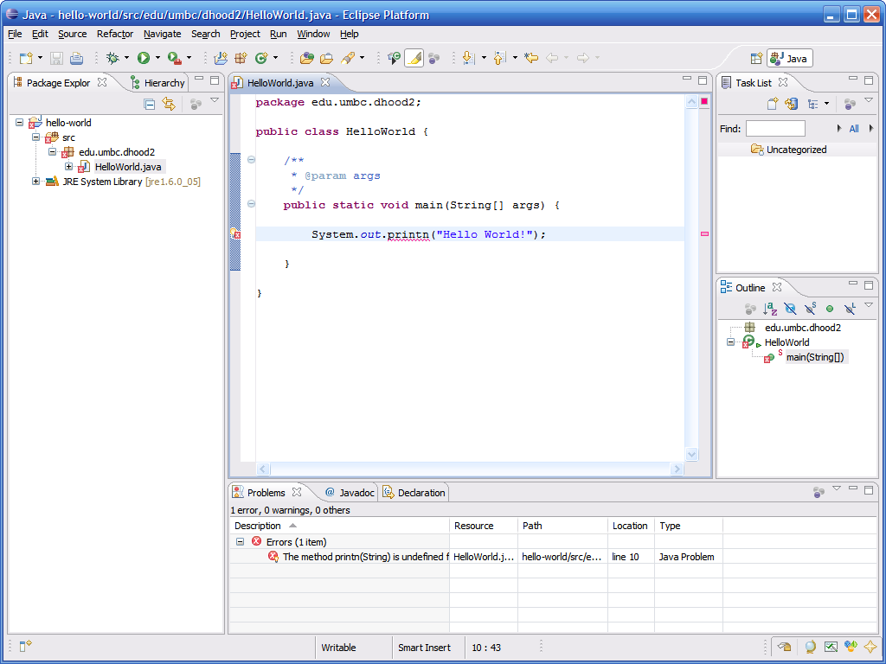
Example Compilation Error
This code contains a typo in the println statement…
Position in file is marked with a red line – 1 click allows you to jump to line with error
Packages/Classes with errors are marked with a red X
Error underlined with red squiggly line (just like spelling errors in many word processors)
Often Eclipse may have suggestions on how to fix the problem – if so, a small light bulb will be displayed next to the line of offending code
Methods with errors are marked with a red X
The Problems tab will contain a tabular representation of all errors across all files of all open projects

Slide 27
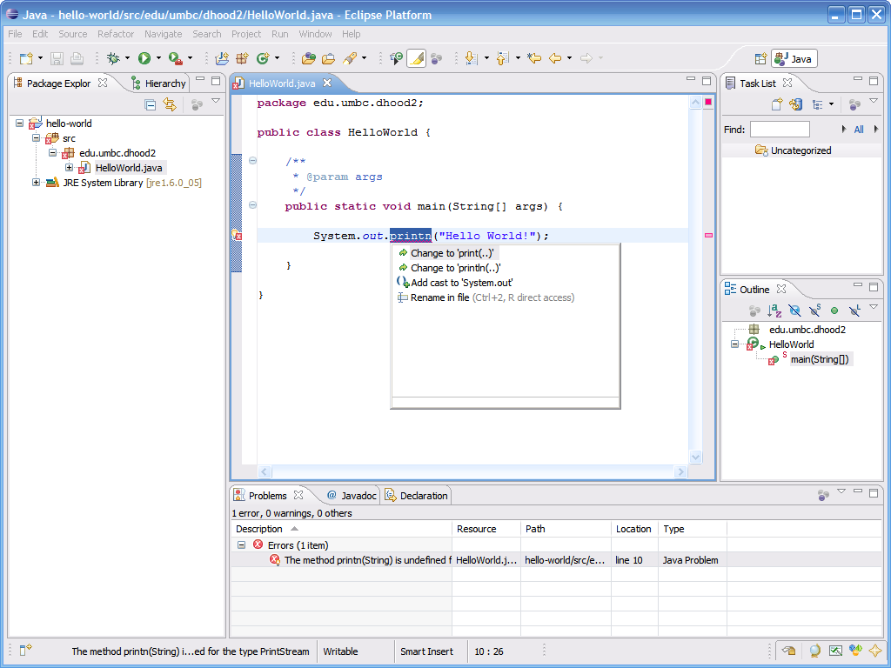
Example Compilation Error (continued)
When clicking on the light bulb, Eclipse suggests changing printn to either print or println

Slide 28
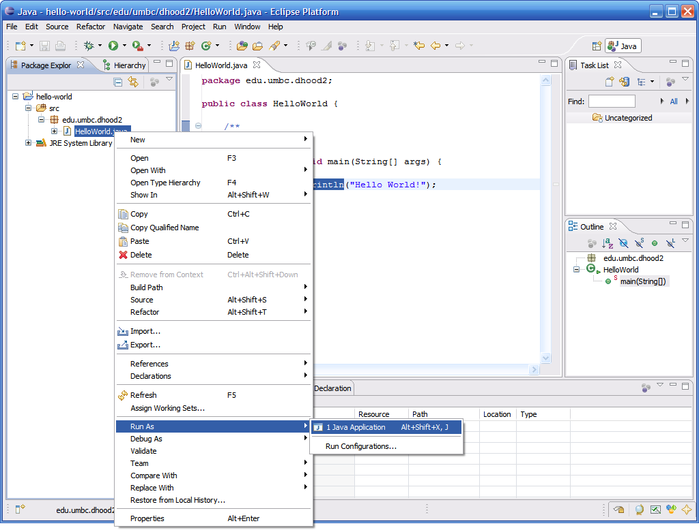
Running Code
An easy way to run code is to right click on the class and select Run As → Java Application

Slide 29
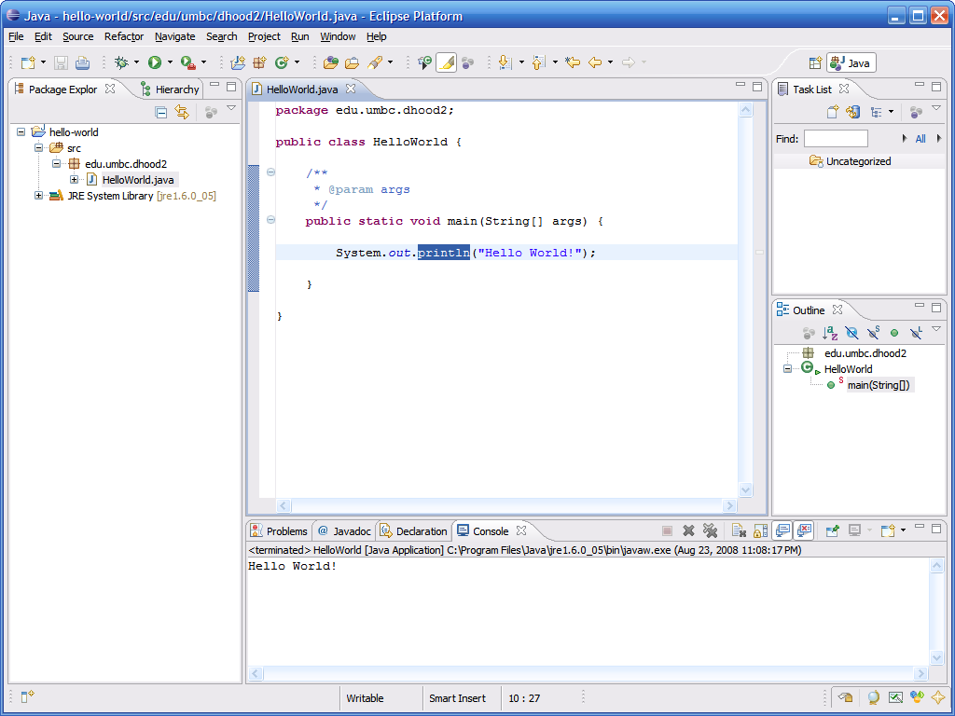
Running Code (continued)
The output of running the code can be seen in the Console tab in the bottom pane

Slide 30
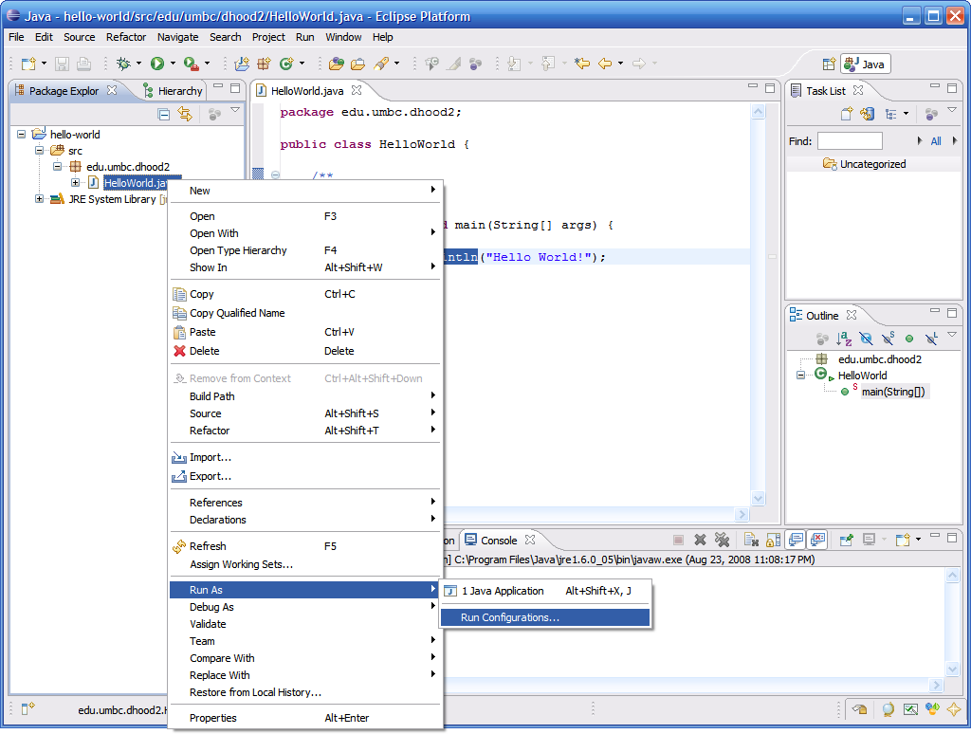
Run Configuration
Advanced options for executing a program can be found by right clicking the class then clicking Run As → Run…

Slide 31
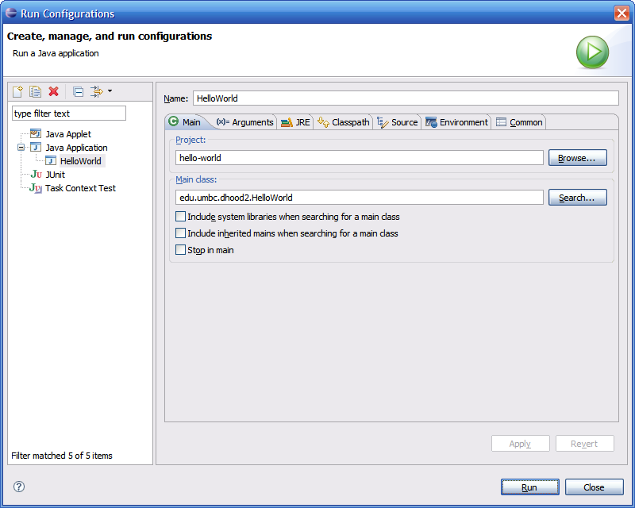
Run Configuration (continued)
Here you can change/add any of the following:
  JVM arguments
  Command line arguments
  Classpath settings
  Environment variables
  Which JVM to use

Slide 32
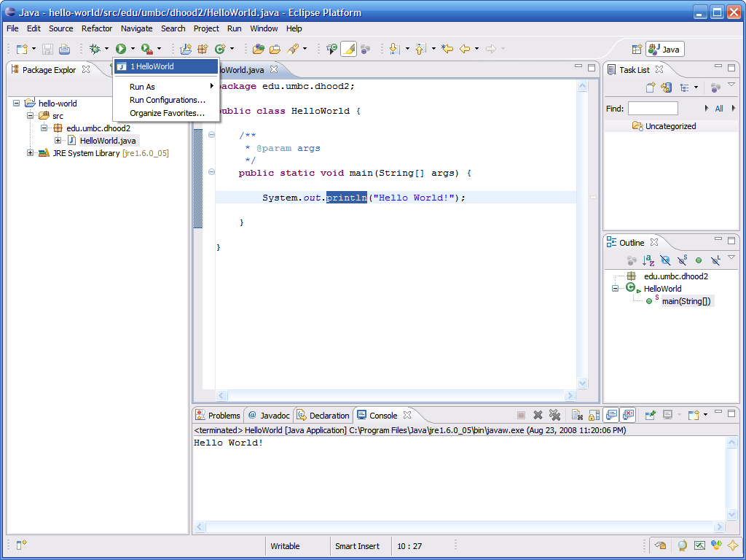
Re-Running Code
After you run the code a first time, you can re-run it just by selecting it from the run drop down menu

